Slide 1


Your Presenter for CRS Activity 610
Al W. Goodman, Jr., CFM
Consultant to the CRS Task Force
Al@awgconsulting.comcastbiz.net
1
Notes:
Contact information for Al.
Good afternoon to those of you who are in the Eastern and Central time zones. I will spend the next 50 minutes or so discussing Activity 610 of the 600 Series. I am assuming at least a basic familiarity of Activity 610 by the webinar participants.
Introduction
This session will serve as an overview of Activity 610. It will provide a background to the activity and give you an idea of what’s important for your community to document, in regard to meeting the activity’s basic credit criteria AND to provide examples of creditable sub-elements.
I must point out that you (as the CRS Coordinator) must involve your emergency management staff. (After all, the 600 Series of Activities are the only CRS activities which are focused on the community’s emergency management program. These are the only life safety evaluations by CRS.)
The single most important tool that I have in this endeavor is the documentation checklist. It is provided to both assist me in evaluating your emergency management flood warning program and to also provide to you a tool in your toolbox to assess your emergency management program as it relates to that same flood warning program.
Click slide.

Slide 2
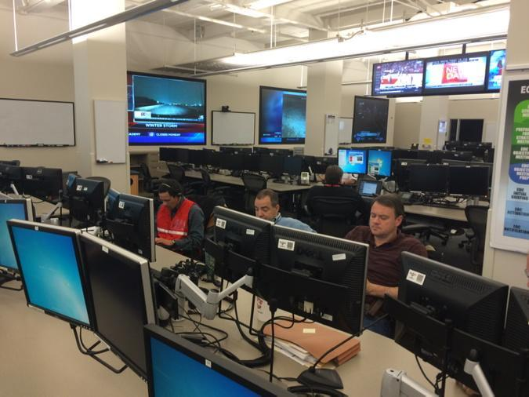

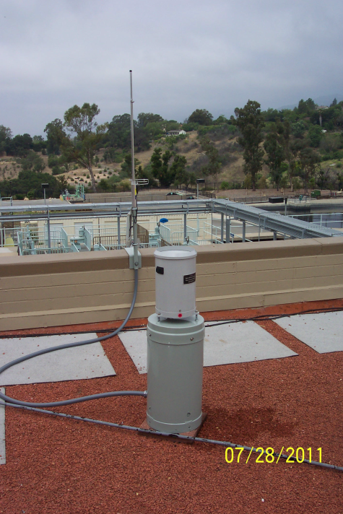
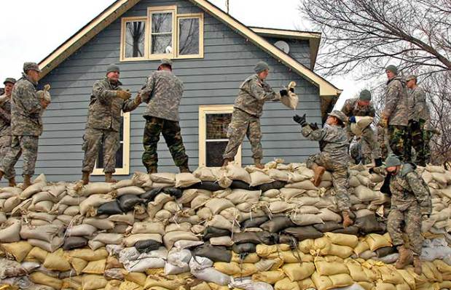
Activity 610: Flood Warning and Response
2
Notes:
Basically, Activity 610 is focused on the principle that an ample warning combined with a flood response plan can prevent loss of life and property damage. This is the only series of activities that look at life safety.
In the case of flood warning and response, communities use Flood Threat Recognition Systems as the basis of warning. The ability to receive notifications on a 24/7 basis is crucial. These systems vary in their level of sophistication, generally based on community vulnerabilities and budgetary constraints. Activity 610 has divided these systems in to Levels 1, 2 and 3. These levels are described in the CRS Coordinator’s Manual on pages 610-5 and 610-6.
For example, the best FTR system is considered to be a Level 3 system (75 points). This system can use Doppler radar real-time data, storm forecast/track modeling and satellite imagery to provide sufficient early warning. ALERT system or IFLOWS precipitation gages, river gages and tidal gages are used to provide everything from flashflood warnings to the timing of potential flood level crests and storm surge heights. From this data, flood inundation and storm surge areas can be developed and mapped. This ties FTR and FRO together.
These technologies are or can be combined with GIS products to provide addressing and individual notifications via text, email or voice calls directly to citizen subscribers with emergency warning information. This ties FTR with EWD.
These FTR systems combined with community comprehensive emergency management plans/flood response plans/emergency operation plans/hazard mitigation plans with associated maps enables emergency warning dissemination to the public and critical facilities. These actions are part of the normal emergency management mission cycle. All are links in the circle, without them all, you have a broken program.
Click slide.

Slide 3

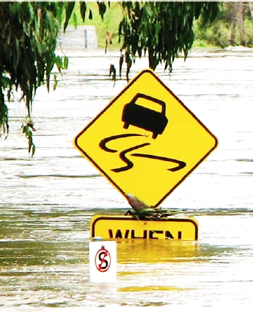
Agenda
  Introduction
  Explanation of the activity’s elements
  Methods of documentation
  Scoring of documentation
  Wrap Up / Summary
  Questions
3
Notes:
Let me briefly review our agenda for this afternoon.
Click slide.

Slide 4

Introduction
  Activity 610 serves to evaluate a community’s emergency management program in regard to its:
  Flood threat recognition system;
  Emergency warning dissemination;
  Flood response operations;
  Critical facility planning, and;
  CRS recognition of the NWS SRC and TRC programs.
4
Notes:
Review the slide.
Of the 21,000+ NFIP member communities in the US, 1,368 are also members of the Community Rating System, which equates to approximately 65% of the flood insurance policies sold through the NFIP. These policies are subsidized by the premiums paid by the non-CRS policyholders.
Click slide.

Slide 5
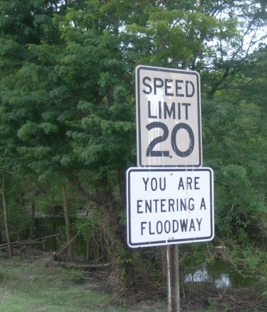
Introduction (continued)
  This activity ties into the stated Goals of the CRS:
  Reduction of flood damage to insurable property;
  Strengthens and supports the insurance aspects of the NFIP, and;
  Encourages a comprehensive approach to floodplain management.
5
Notes:
Review the slide.
As I have previously mentioned, Activity 610 evaluates those measures that protect life and property during a flood through flood warning and response programs. Its four sub-elements of FTR, EWD, FRO and CFP are tied together in order to emulate your community’s emergency management program.
An added benefit of pursuing 610 credit is that it encourages the community’s emergency management to review its flood warning program in regard to development and documentation of its entire scope of flood warning capabilities.
Click slide.

Slide 6
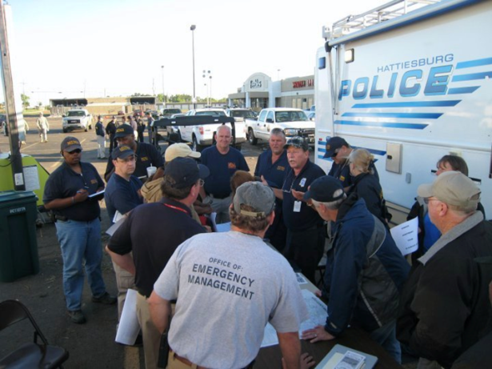
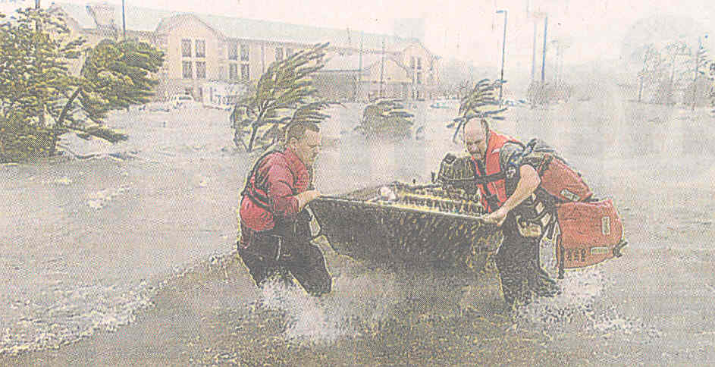
Introduction (conclusion)
  Emergency Management Focused:
  Roles of the local emergency manager, in regard to:
    Advancing Public Safety;
    Property Protection, and;
    Disaster resiliency / recovery through the NFIP and the CRS programs.
6
Notes:
Review the slide.
Emergency management’s daily mission is best described by these five phases:
Prevention
Preparedness
Response
Recovery, and
Mitigation
By now, you should be thinking “Who is my emergency manager?” or if you are the emergency manager “I guess I should be coordinating our Activity 610 credit.”
Click slide.

Slide 7
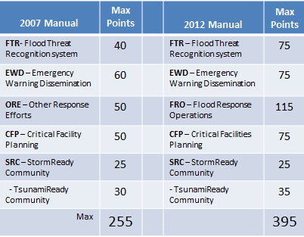
Activity Elements
7
Notes:
I have this slide in the deck to show y’all how much the activity has changed in regard to total points available. This was a result of the the FEMA “Weighting Forum” that met in Philadelphia, PA in 2011. These weight changes reflected a better knowledge of how CRS activities can shift community behavior.
The credit criteria were revised to encourage more attention to pre-planning response actions at different predicted flood levels. ISO began the first webinars to assist communities in these changes in July of 2011. So, we are going into the fifth year of webinars and newsletters covering these adjustments. So, this shouldn’t be new anymore.
Click slide.

Slide 8
Activity Elements (continued)
Documentation: FTR
Complete documentation checklist for tech reviewer:
  Community’s flood hazard description;
  Community’s flood inundation map;
  Copy of adopted flood warning and response plan (marked up);
  Description of flood threat recognition system;
  Copy of maintenance procedures for any community owned gages;
  Impact adjustment map showing how the number of buildings used were determined;
  Copy of outreach materials, and;
  Description of flood exercise, with an AAR / lessons learned.
8
Notes:
Review the slide.
Click slide.

Slide 9
Activity Elements (continued)
Documentation: EWD
Complete documentation checklist for tech reviewer:
  Copy of adopted flood warning and response plan (marked up);
  Copy of outreach materials credited under EWD;
  Copy of pre-scripted messages;
  Impact adjustment map showing siren locations and coverage areas;
  Description of publicly owned call system or contract with provider;
  Copy of cable agreement and override procedures;
  Description of other forms of public notification, and;
  Description of flood exercise and AAR or lessons learned.
9
Notes:
Review the slide.
Click slide.

Slide 10
Activity Elements (continued)
Documentation: FRO
Complete documentation checklist for tech reviewer:
  Copy of adopted flood warning and response plan (marked up);
  Copies of documents credited under FRO, if they are not in the flood warning and response plan, and;
  Description of flood exercise and AAR or lessons learned.
10
Notes:
Review the slide.
Click slide.

Slide 11
Activity Elements (continued)
Documentation: CFP
Complete documentation checklist for tech reviewer:
  A list of all public and private critical facilities affected by flooding, with contact information and agreed-upon warning needs;
  A list of all critical facilities that have developed their own flood warning and response plans (reviewed and accepted by community), and;
  Sample page from latest list of critical facilities (updated annually).
11
Notes:
Review the slide.
Click slide.

Slide 12
Activity Elements (continued)
  There are six credit criteria in Section 611.b.:
  Must obtain credit in the first four elements (FTR, EWD, FRO and CFP) to receive any credit.
  The community must have a description of its flood hazard that includes:
    Nature, flood depths, velocities, warning times, historical flood problems and special flood-related hazards;
1
2
12
Notes:
Let’s now look at the six credit criteria for 610. During my tech reviews, if the community does not meet one of these criteria, then zero credit will be assigned, regardless of any possible points in any of the sub elements that could be assigned. Also, SRC/TRC credit cannot be assigned in a vacuum.
Review the slide. Slide is continued on next slide.
Click slide.

Slide 13
Activity Elements (continued)
  There are six credit criteria: (continued)
  The community must have a description of its flood hazard that includes: (conclusion)
    Development exposed to flooding, such as number and types of buildings, land use, critical facilities and historic flood problem areas, and;
    Expected impacts of flooding on health and safety, community functions and potential for secondary hazards.
13
Notes:
Review the slide.
Local governments probably already have various plans or risk assessments that meet this criterion. If not, it is recommended that the community complete the CRS Community Self-Assessment described in Section 240 of the Coordinator’s Manual.
Click slide.

Slide 14
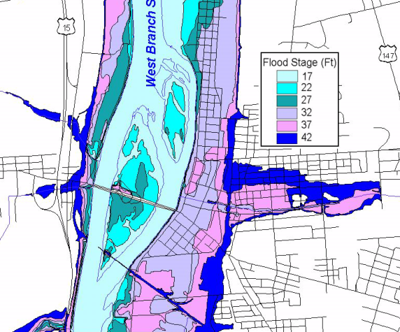
Activity Elements (continued)
  There are six credit criteria: (continued)
  Must have a flood inundation map(s) that depicts at least two different storm surge levels for a coastal community and three or more for a riverine community.
3
14
Notes:
Review the slide.
It could be a paper product, such as depicted on this slide. The FEMA developed FIRM is not considered to be a flood inundation map. It is an insurance rating map.
Click slide.

Slide 15
Activity Elements (continued)
15
Notes:
Review the slide.
This is the example found in the manual. (figure 610-1)
Click slide.

Slide 16
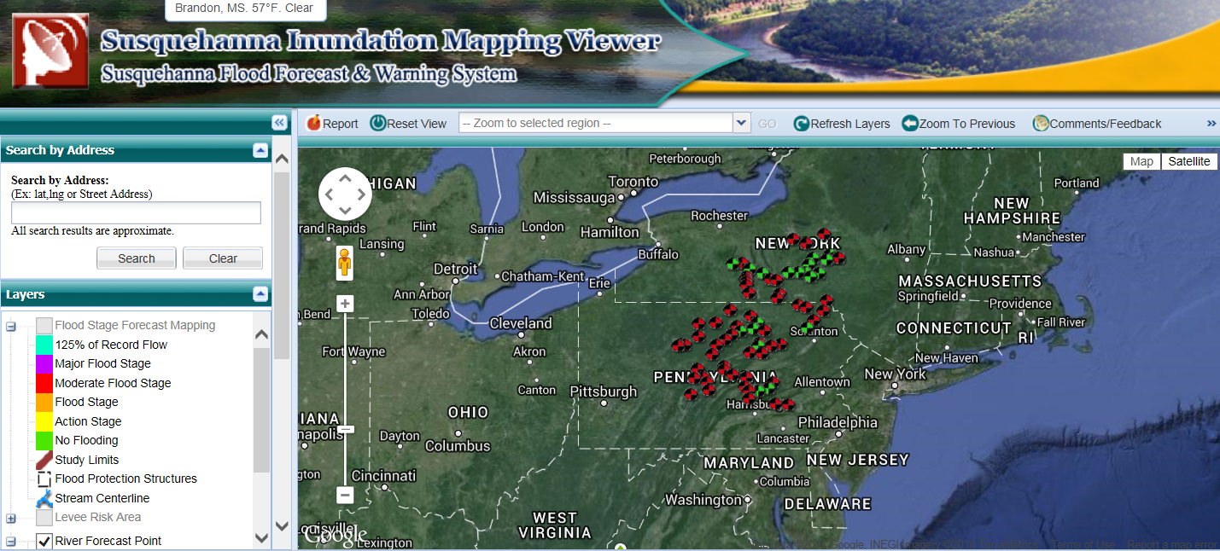
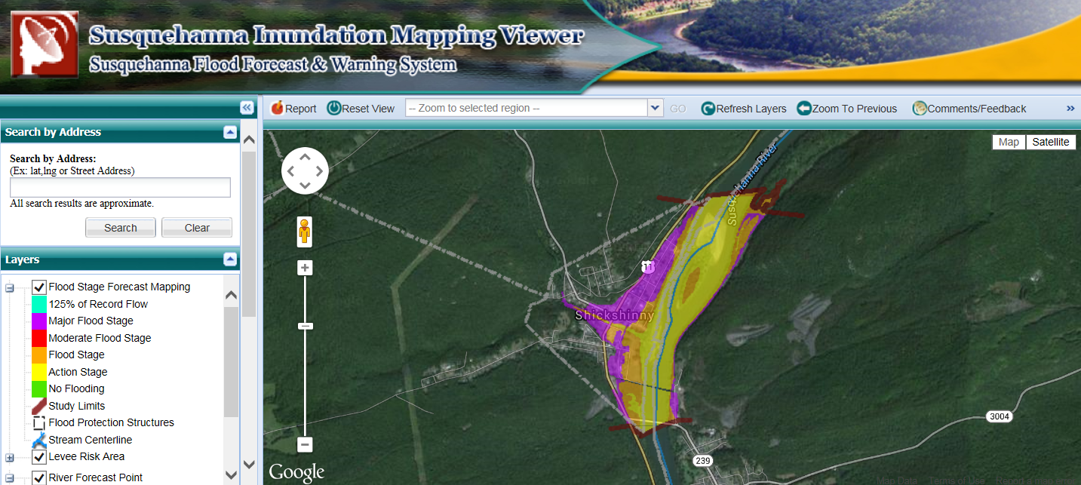
16
Notes:
Review the slide.

Slide 17
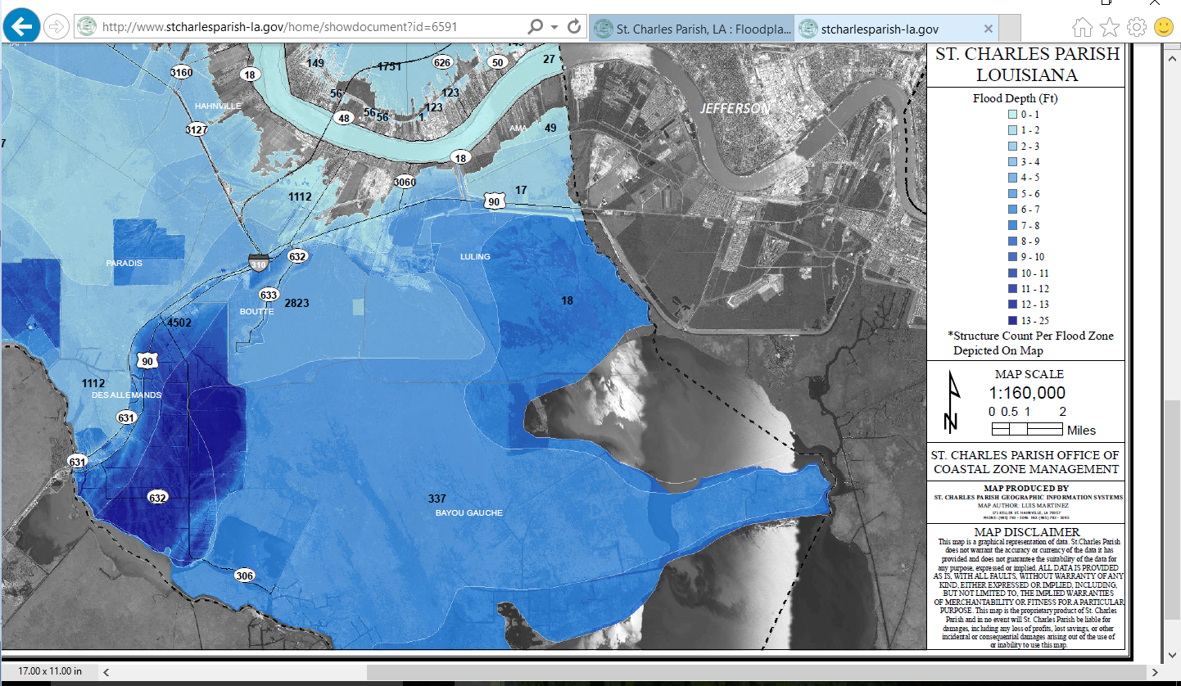
Activity Elements (continued)
17
Notes:
Your flood inundation map could be a completely digital or web based product, as shown here.
Review the slide.
Click slide.

Slide 18
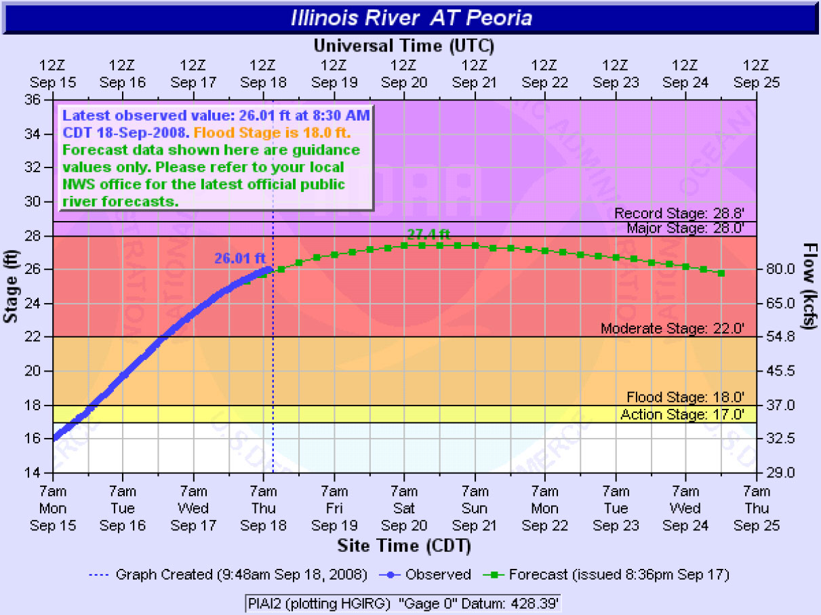
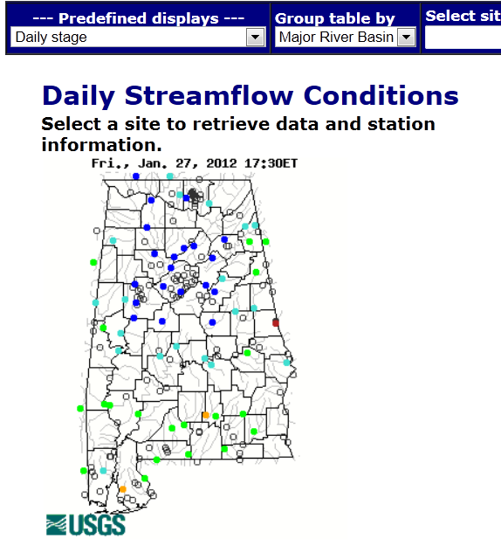
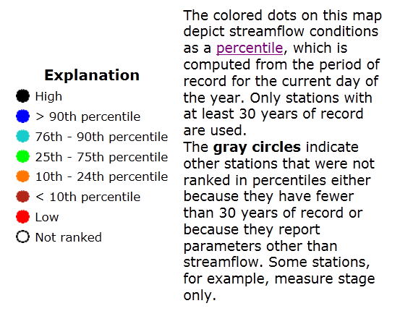
Activity Elements (continued)
18
Notes:
Review the slide (plus on click).
Click slide.

Slide 19
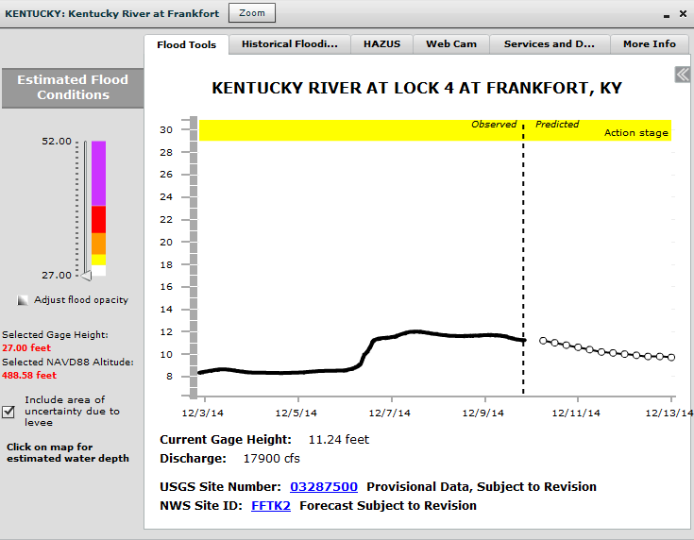
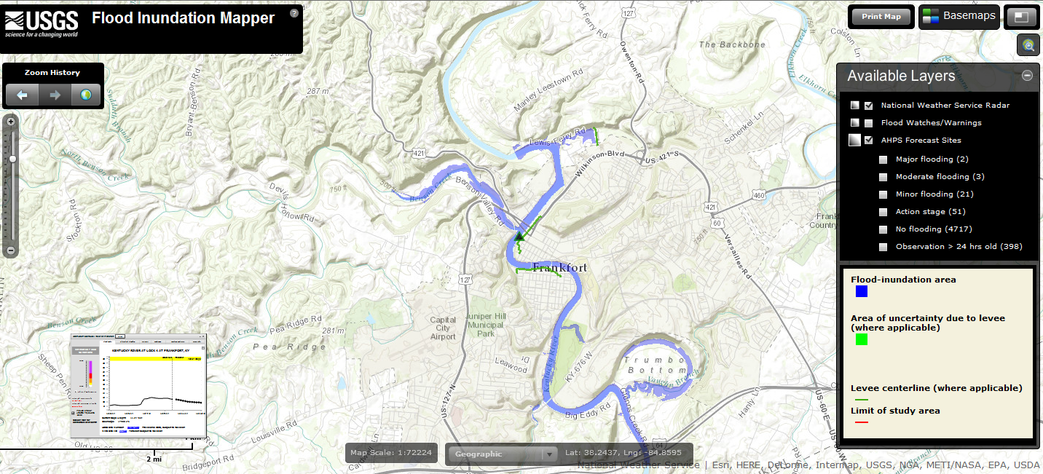
Activity Elements (continued)
19
Notes:
Review the slide. Frankfort, KY.
Click slide.

Slide 20
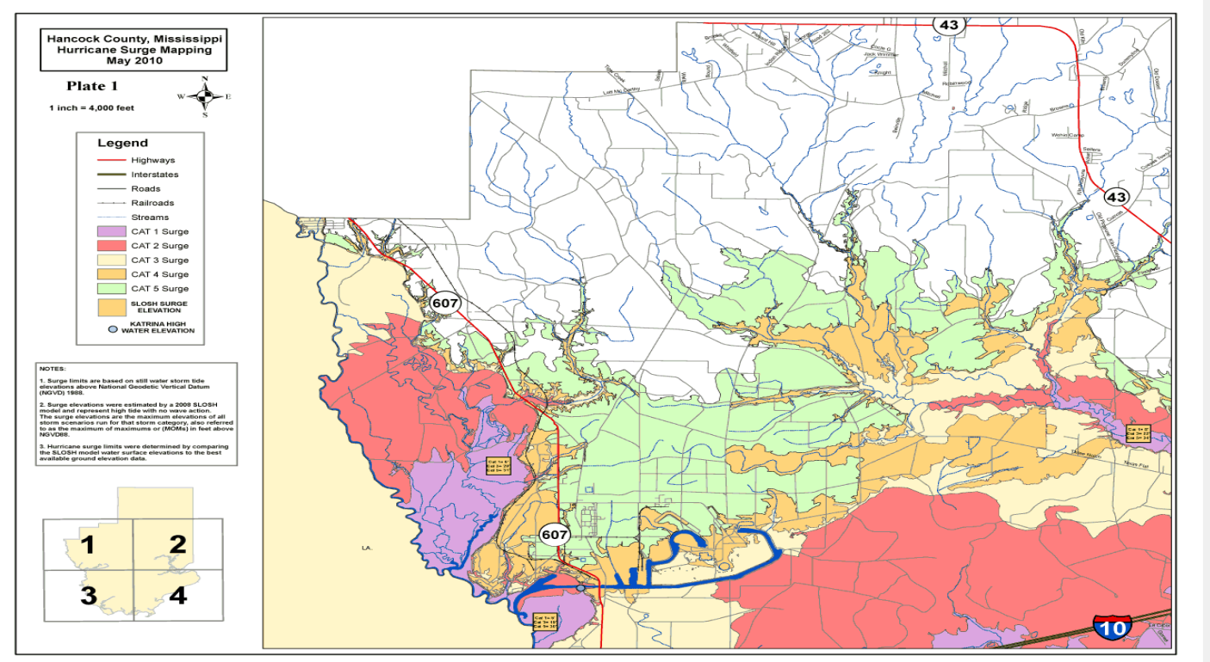
Activity Elements (continued)
20
Notes:
Review the slide.
Harrison County, MS. A coastal community may have a SLOSH generated map, which represents the majority of its flood risk. SLOSH stands for “Sea, Lake and Overland Surges from Hurricanes.”
Click slide.

Slide 21
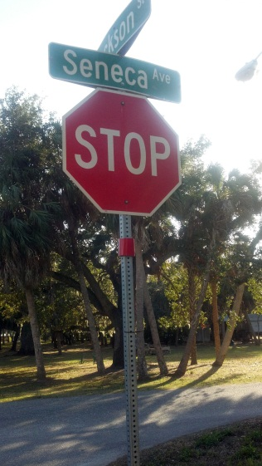
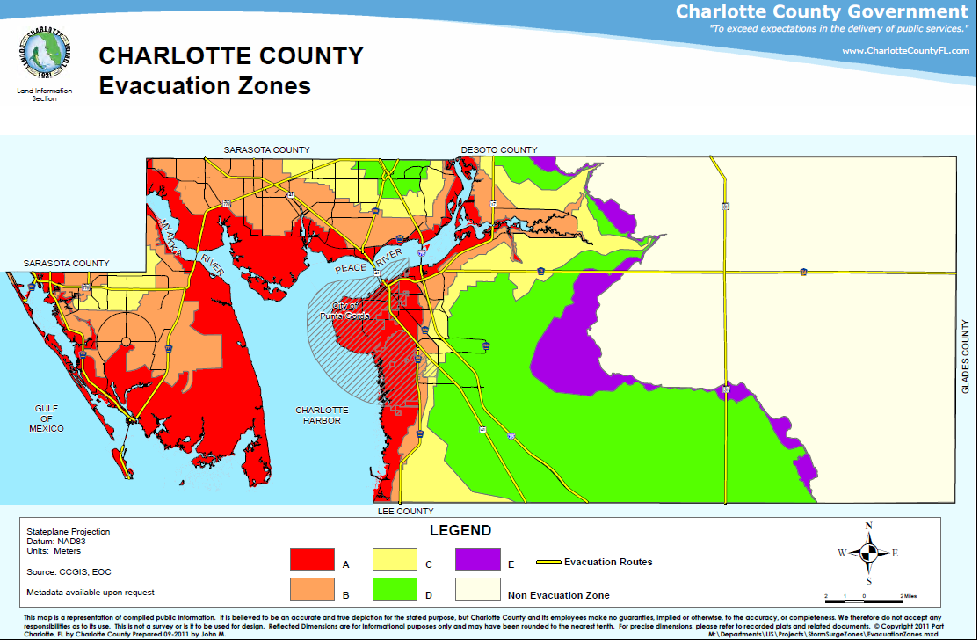
Activity Elements (continued)
  Must have a flood inundation map(s):
21
Notes:
Charlotte Co., FL. A SLOSH map can be used to develop evacuation zones, which are used in community outreach and are discussed in the evacuation plan. Color coded bands on all stop signs in evacuation zones that match the evac zone colors. I have seen some with letters also, for colorblind people.
Click slide.

Slide 22
Activity Elements (continued)
  There are six credit criteria: (continued)
  The community must have an adopted flood warning and response plan that:
    Describes the methods and warning devices used to disseminate emergency warnings to the general public that are credited under EWD;
    Include specific flood response actions that are taken at the different flood/surge levels that are credited under FRO, and;
4
22
Notes:
A flood warning and response plan may have different names in different communities, such as flood warning plan, flood preparedness plan or flood annex to an emergency operations plan.
Review the slide.
Click slide.

Slide 23
Activity Elements (continued)
  There are six credit criteria: (continued)
  The community must have an adopted flood warning and response plan that: (conclusion)
    Be adopted by the community’s governing body or by an office that has been delegated approval authority by the governing body.
23
Notes:
Review the slide.
If the plan is prepared at the county or parish level, it must be adopted by the individual communities that seek credit for it. Annexes, SOPs and other documents do not require formal adoption by the governing body. If the county, borough or parish plan lists the community by name and it is acknowledged by community signature, then it is considered adopted.
Click slide.

Slide 24
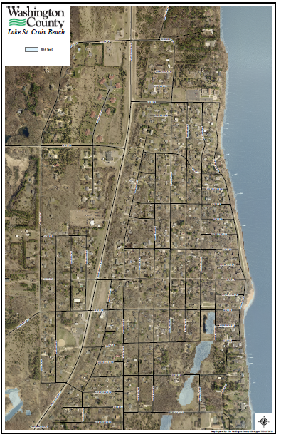
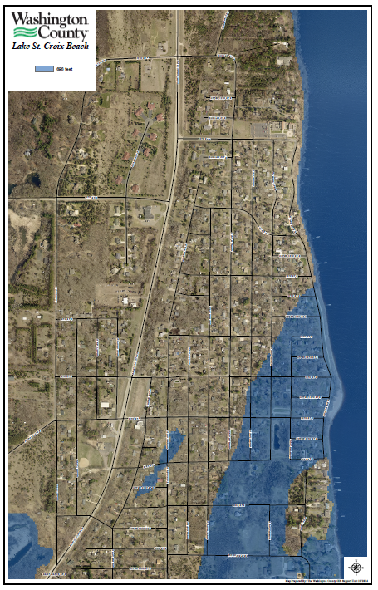
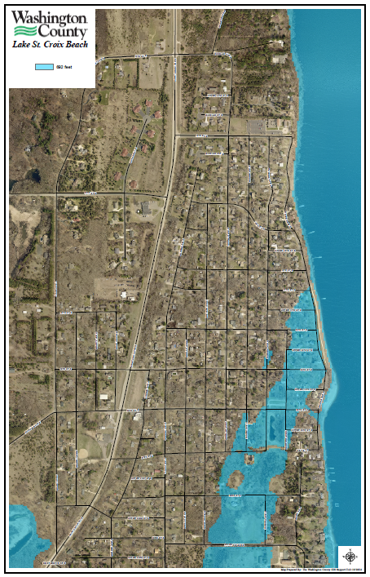
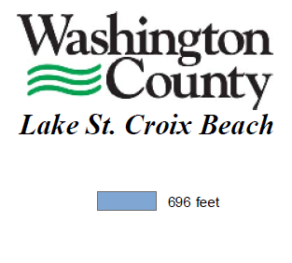
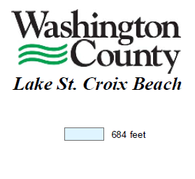
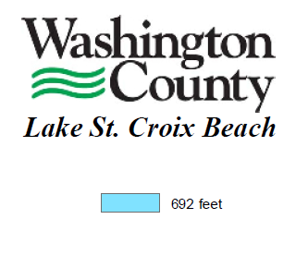
Notes:
Lake St. Croix Beach, MN. Describe the maps.
Four clicks.

Slide 25
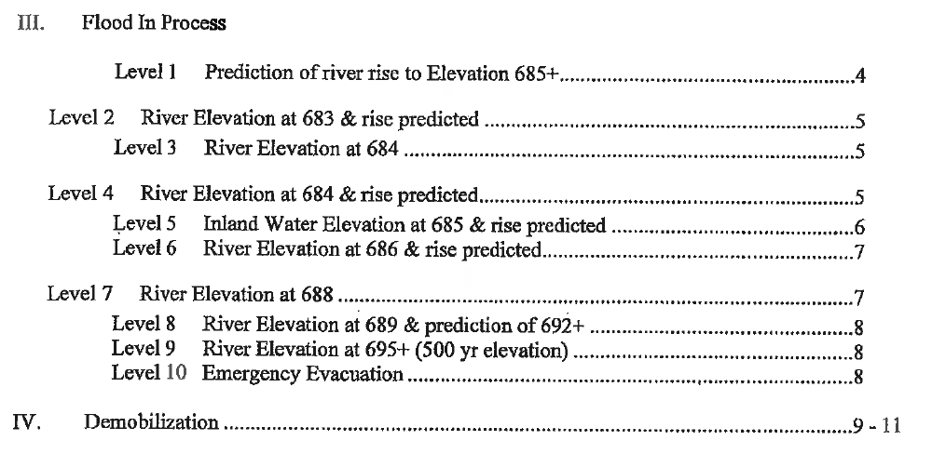
Activity Elements (continued)
25
Notes:
Review the slide.
Click slide.

Slide 26
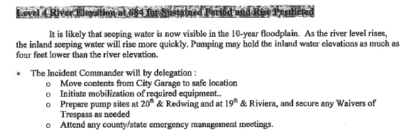
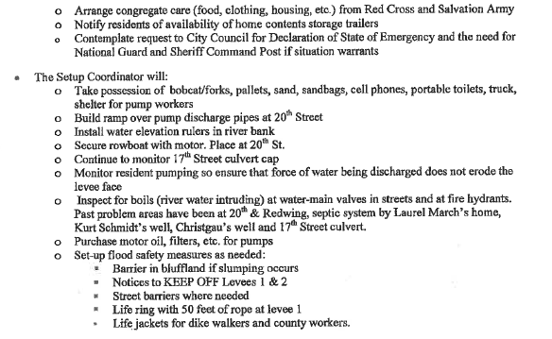
Level 4 River Elevation at 684 for Sustained Period and Rise Predicted
26
Notes:
One Click.
You can’t see the heading, so I’ve added an insert for you.

Slide 27
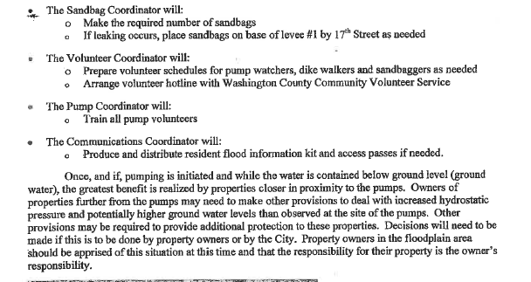
27
Notes:
Review the slide.
Click the slide.

Slide 28
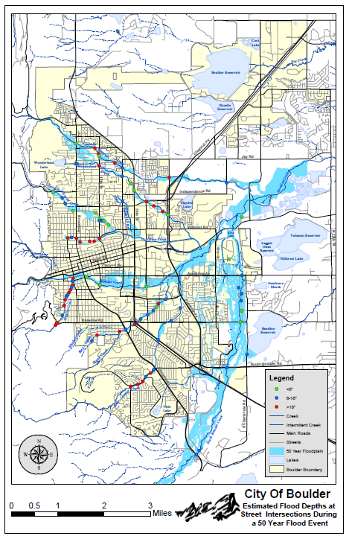
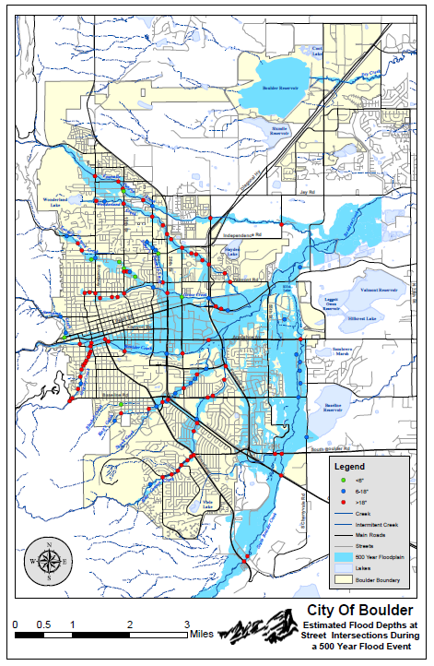

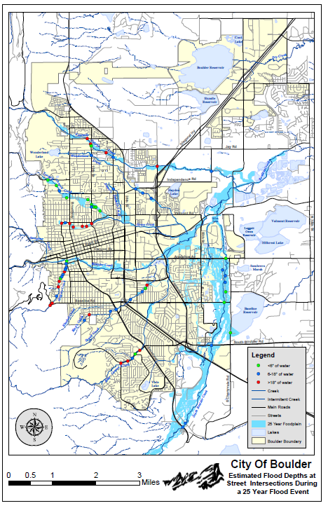
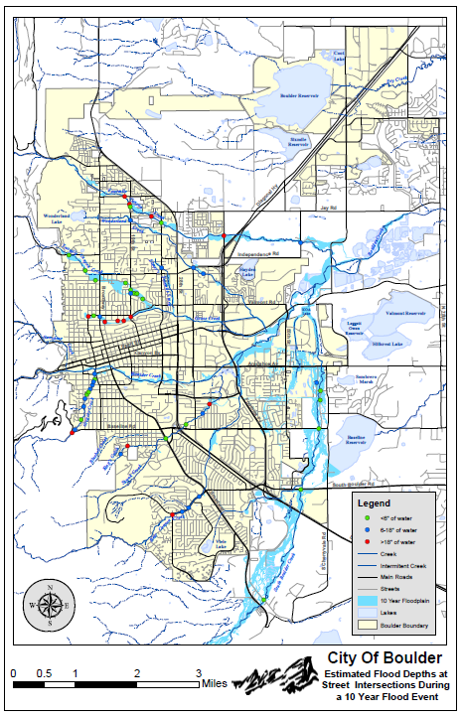
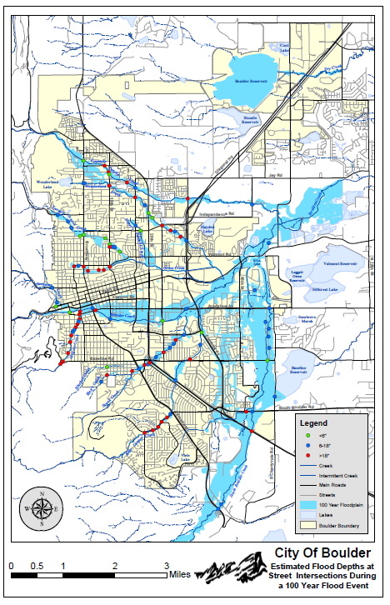
28
Notes:
This community has five maps, depicting flood levels.
The plan addressed the five levels.
One click.

Slide 29
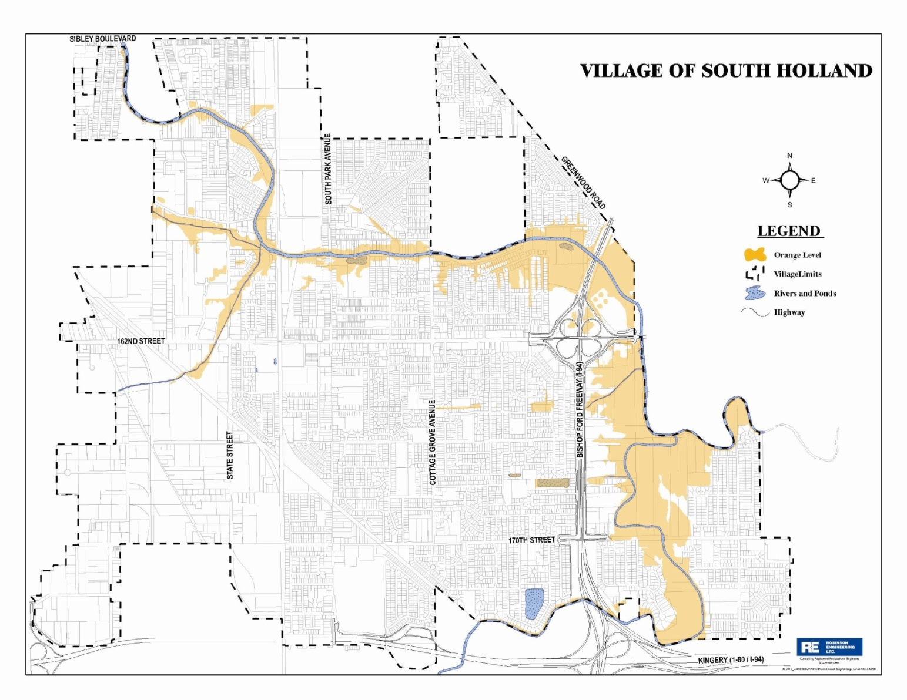
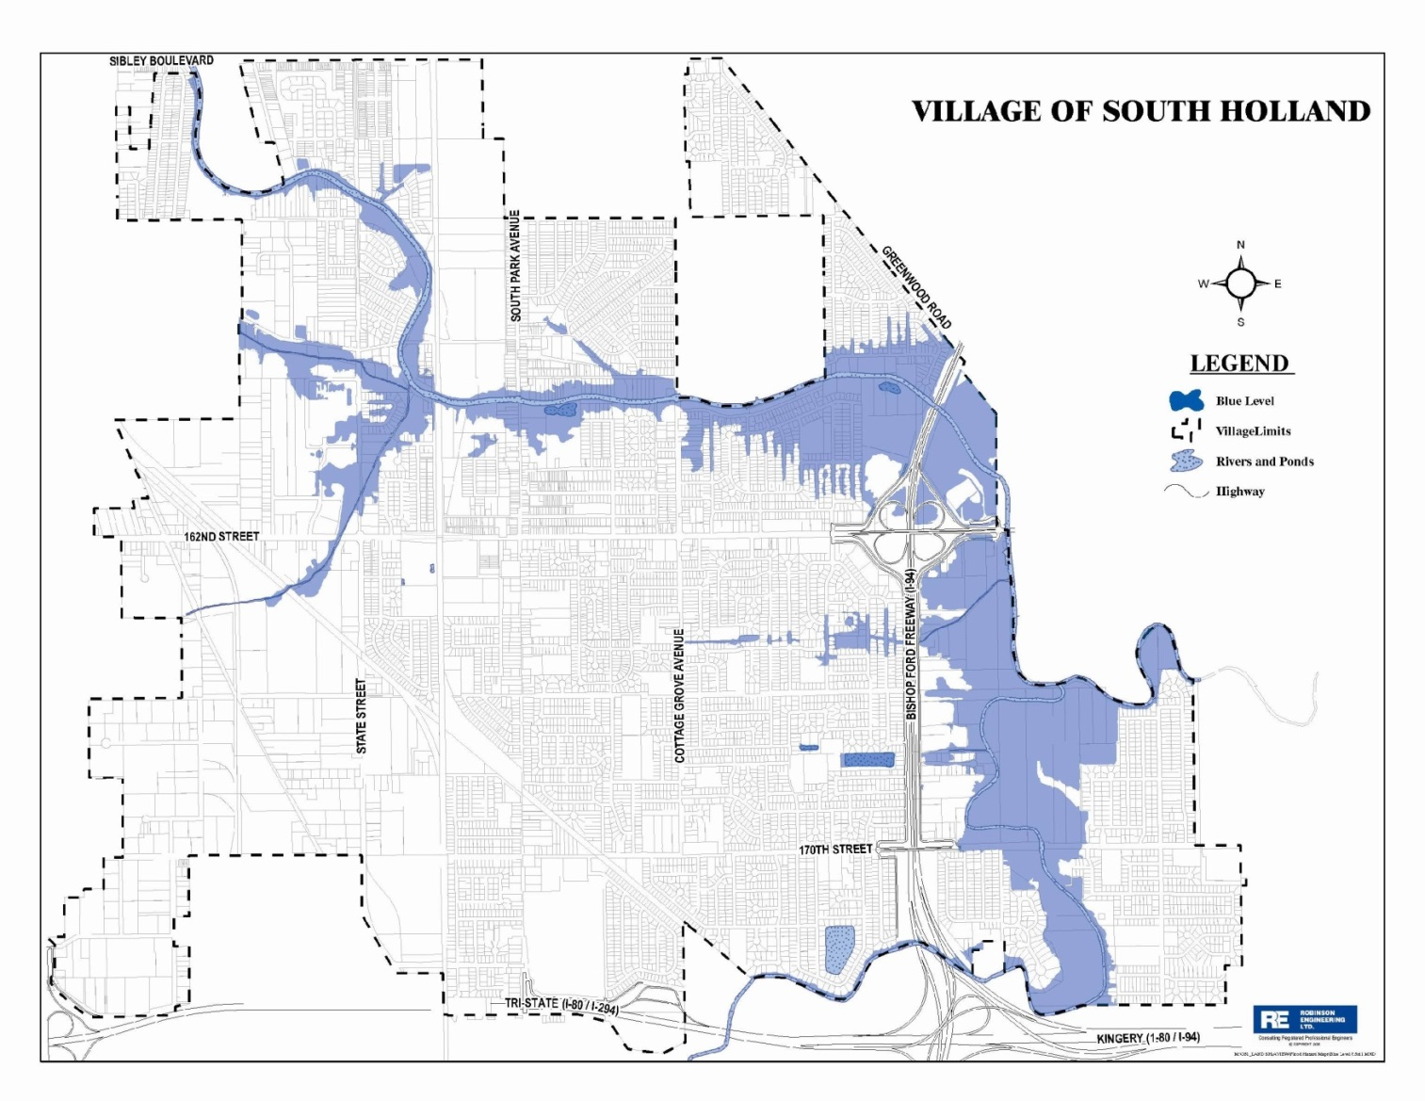
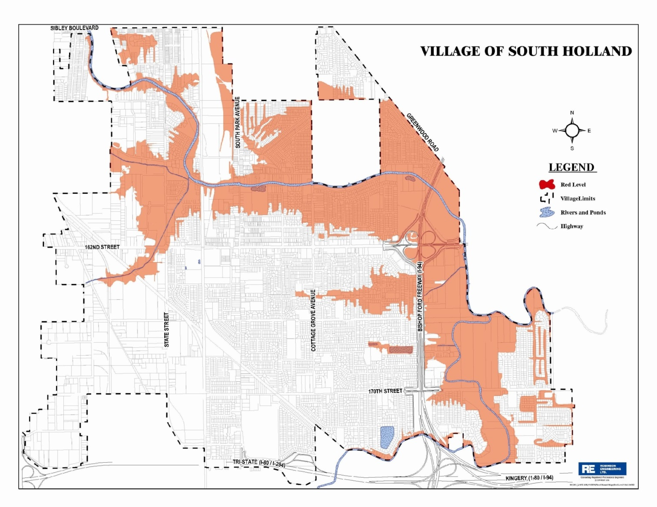
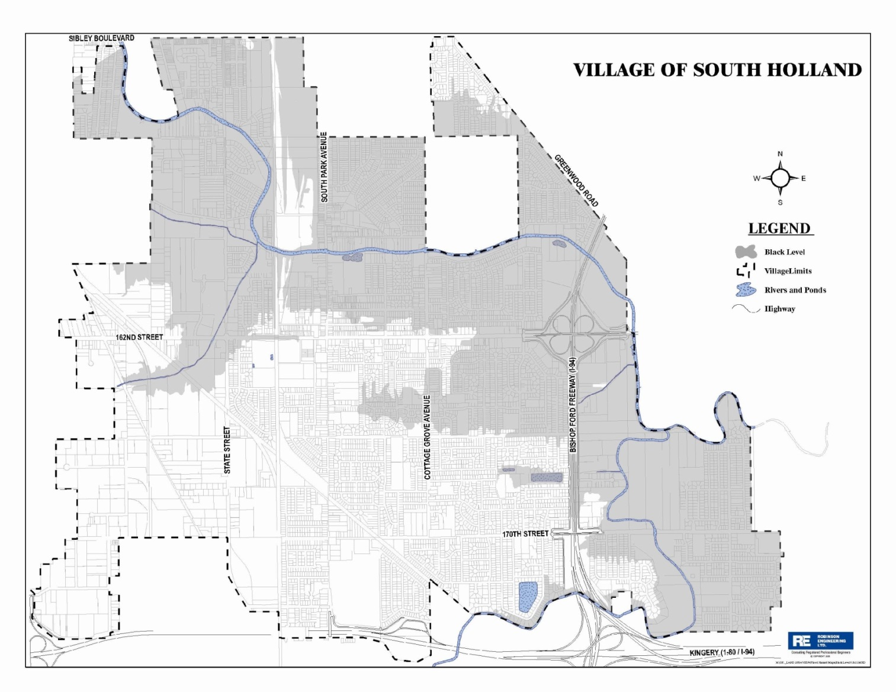
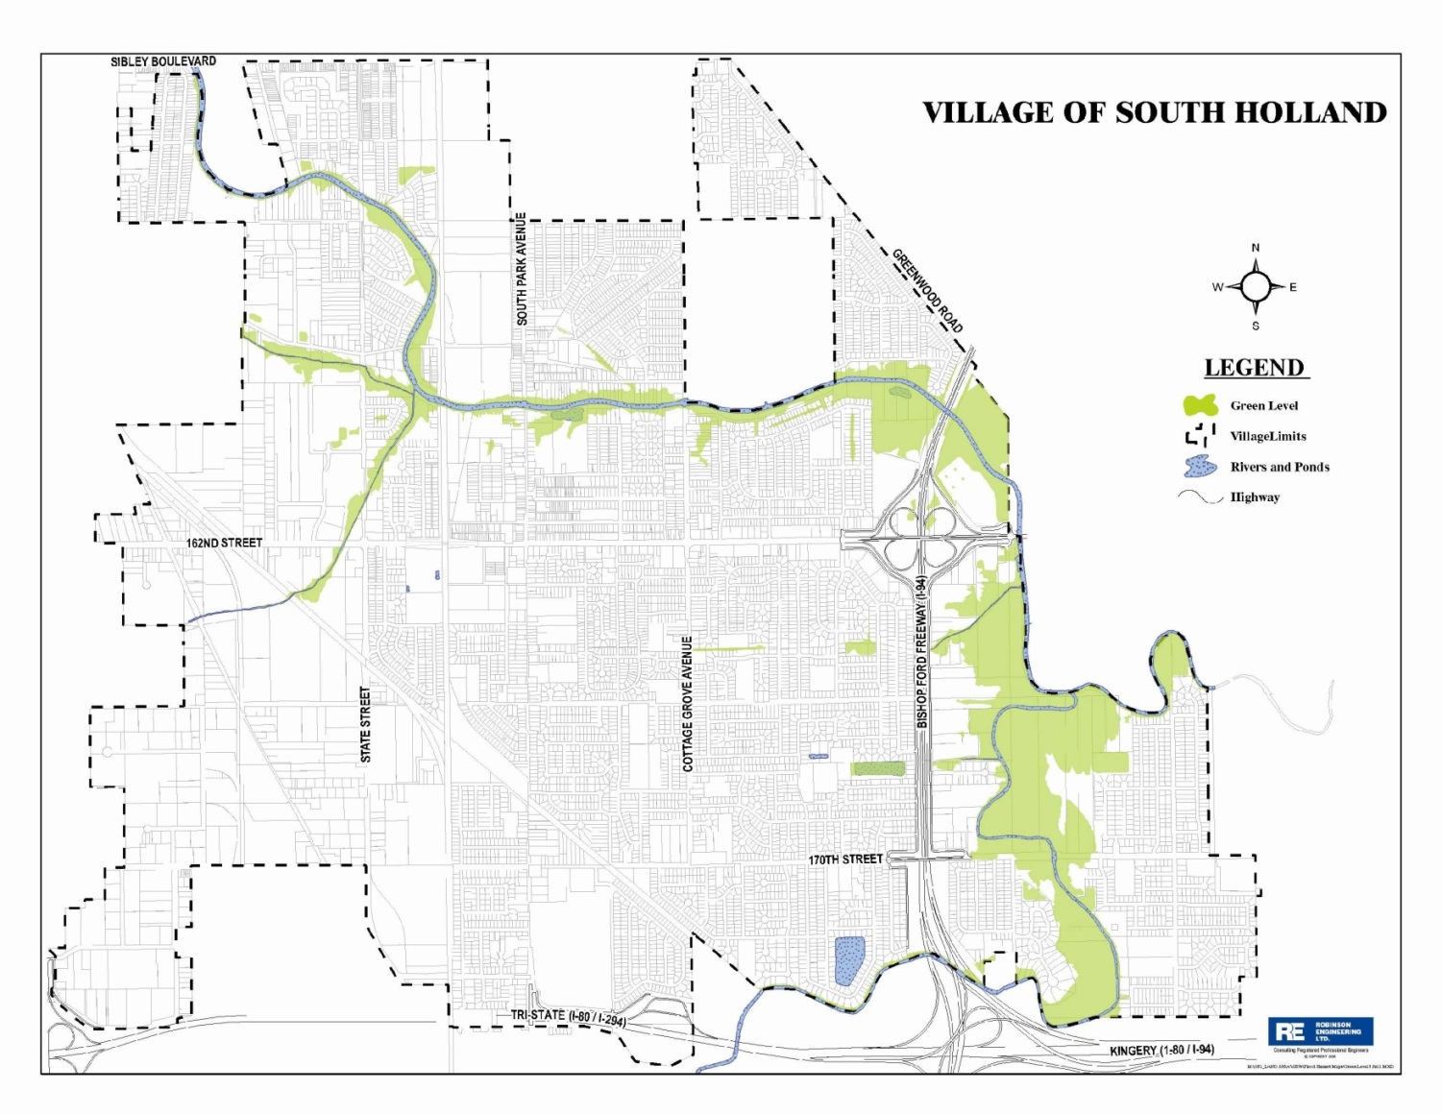
Activity Elements (continued)
29
Notes:
This is the village of South Holland, IL. This has been the standard example of flood inundation layers and a correlated plan for years.
Review the slide and click slide.

Slide 30
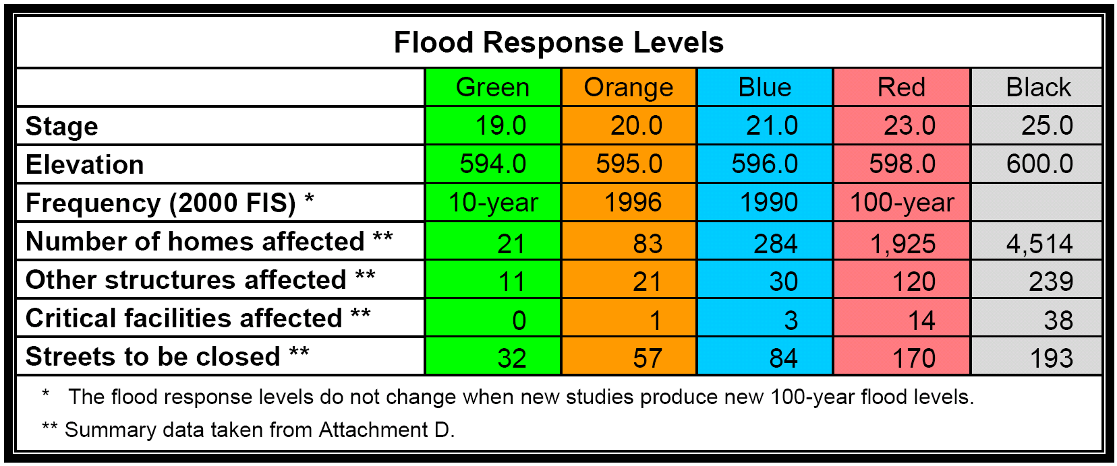
Activity Elements (continued)
30
Notes:
Review the slide.
The village’s plan addresses the various flood inundation levels and describes the actions taken at each level.
Click slide.

Slide 31
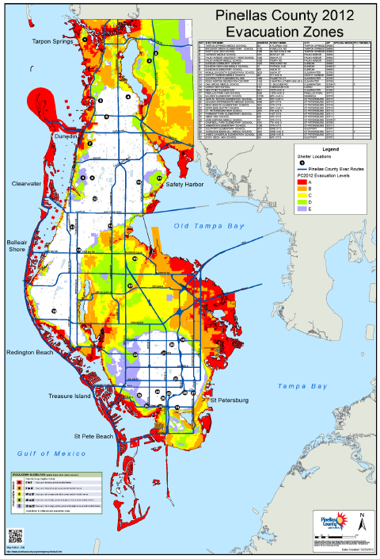
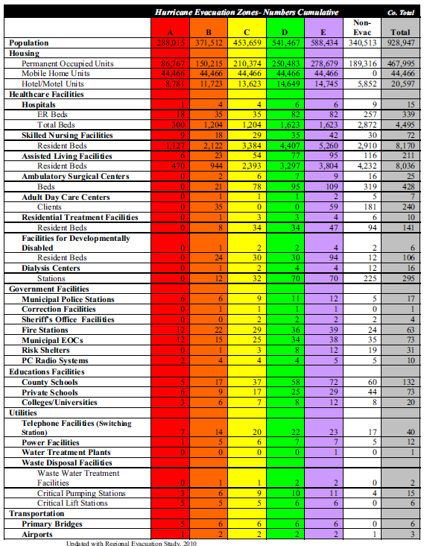
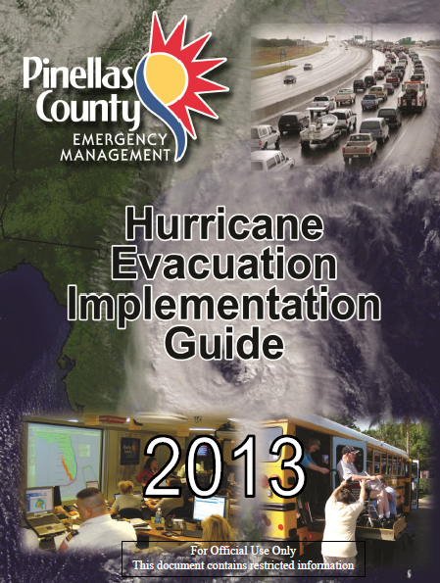
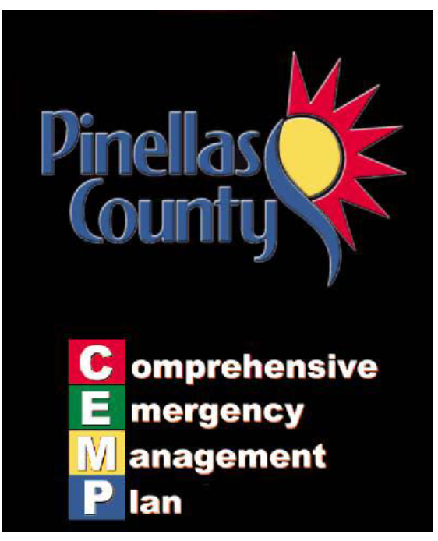
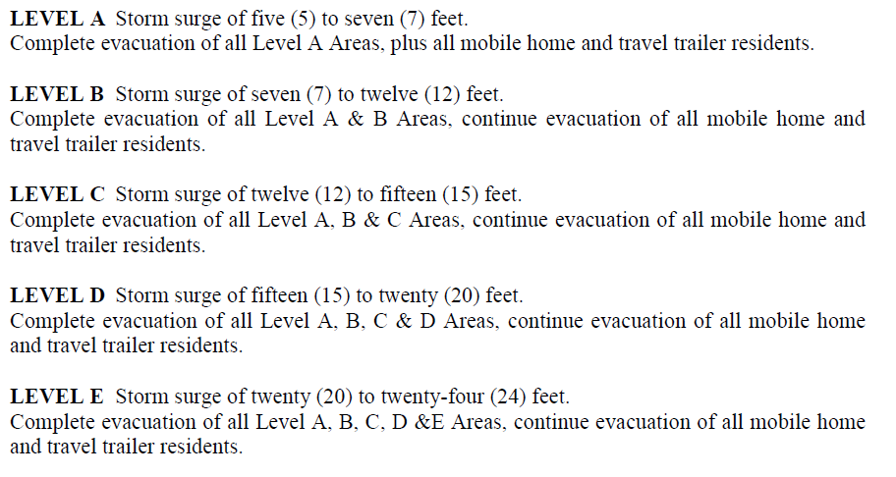
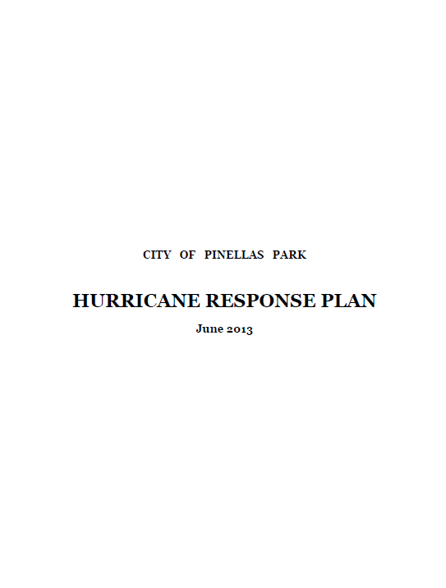
31
Notes:
Coastal community, using the SLOSH generated hurricane evac zones. The plan identifies the zones, tied to the FTR system, FRO, EWD, CFP.
Click twice.

Slide 32
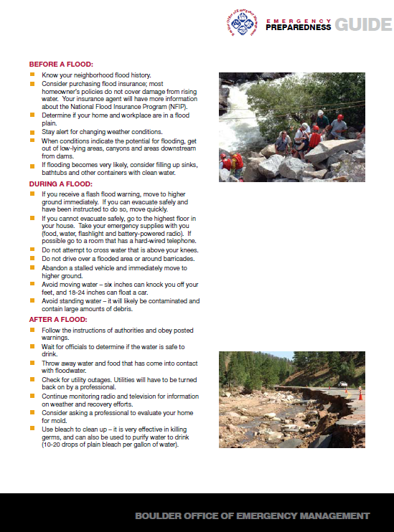
Activity Elements (continued)
  There are six credit criteria: (continued)
  The community must implement one or more outreach projects that tells its residents and businesses how they will be warned and the safety measures they should take during a flood.
5
32
Notes:
Review the slide.
Click slide.

Slide 33
Activity Elements (continued)
  There are six credit criteria: (continued)
  Outreach projects: (continued)
    Send a brochure/letter/newsletter each year to all residents and businesses in the community;
    Send an outreach project each year to all residents and businesses in the floodplain where the warning program is in effect;
    Develop an approach as part of a Program for Public Information (PPI) under Activity 330;
33
Notes:
Review the slide.
Click slide.

Slide 34
Activity Elements (continued)
  There are six credit criteria: (continued)
  Outreach projects: (continued)
    IF the community has at least three days of flood notification, it may document that it provides repeated watch, warning and safety information to all residents and businesses beginning at least 72 hours in advance of predicted flooding; or
34
Notes:
Review the slide.
Click slide.

Slide 35
Activity Elements (continued)
  There are six credit criteria: (continued)
  Outreach projects: (conclusion)
    A community with more than one source of flooding may need to use different types of approaches to reach different audiences.
35
Notes:
Review the slide.
This type of community might have both coastal and riverine flood areas.
Click slide.

Slide 36
Activity Elements (conclusion)
  There are six credit criteria: (conclusion)
  There must be at least one exercise and evaluation of the flood warning and response plan each year. The exercise can be for a flood, levee failure, dam failure or hurricane. This criterion can be met if the plan is implemented in response to an actual event. In either case, there must be an evaluation of the performance of the plan and recommended changes.
6
36
Notes:
Review the slide.
Emergency managers routinely produce After Action Reports or Lessons Learned documents after each drill/exercise/table top/actual event. The DHS National Exercise Program (NEP) is used to examine the preparedness and readiness of the nation. It uses the Homeland Security Exercise and Evaluation Program (HSEEP) methodology and related tools and resources.
If the exercise took place at the county, borough or parish level, the community must produce documentation of its participation in the exercise.
Click slide.

Slide 37
Methods of Documentation
  It would be prudent for a community to review the CRS Coordinator’s Manual before documentation collection begins. This will serve to:
  Understand what is actually requested;
  Enhance the emergency manager’s understanding of why it is necessary to participate in the community’s CRS program, and;
  Provide the reasoning behind the extensive documentation checklist.
37
Notes:
Review the slide.
Click slide.

Slide 38
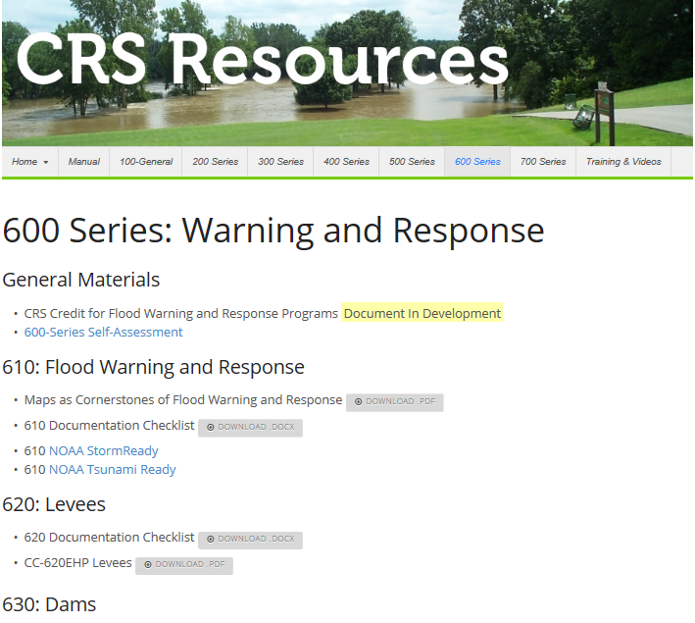
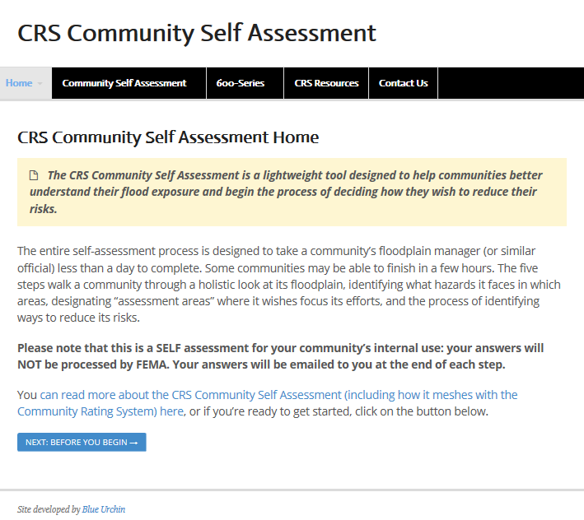
Methods of Documentation (continued)
  There is a web based self assessment tool for Activity 610: Flood Warning & Response:
38
Notes:
Review the slide.
Click slide.

Slide 39
Methods of Documentation (continued)
  An Activity 610 Documentation Checklist (8/2015) has been provided to allow the community’s Emergency Manager and CRS Coordinator to review their flood warning program.
  http:crsresources.org/600-2/
39
Notes:
Review the slide.
If you do not yet have the August 2015 checklist, you can download it from this site.
Click slide.

Slide 40

Methods of Documentation (continued)
40
Notes:
Review the slide. Screen shot of the page.
Click slide.

Slide 41


Methods of Documentation (continued)
41
Notes:
The checklist is a total of 14 pages, with the first four pages serving as a “sales brochure” for the activity. It was designed to capture the interest of an emergency manager.
The actual checklist begins on page 5.
Review the slide.
Click slide.

Slide 42
42
Notes:
Review the slide and click.

Slide 43

43
Notes:
Give examples of why this was inserted.

Slide 44

44
Notes:
Click twice.
The red boxes are the sections that I can quickly scan to see if any credit will be available.

Slide 45

45
Notes:
Click three times.

Slide 46

46
Notes:
Click one time.

Slide 47

47
Notes:
Click one time.

Slide 48

48

Slide 49

49

Slide 50

50

Slide 51

51

Slide 52

Methods of Documentation (conclusion)
52
Notes:
Click one time.

Slide 53


Scoring of Documentation
53
Notes:
This is a sample of my scoring sheet that is sent to ISO. It follows the Coordinator’s Manual and Documentation Checklist’s format. Describe what is indicated by the score sheet depicted.
Review and Click slide.

Slide 54

54
Notes:
Describe what is indicated by the score sheet.

Slide 55


Scoring of Documentation (conclusion)
55
Notes:
These are the final two pages of the score sheet. I have enlarged them on the next two slides.
Click slide.

Slide 56
56
Notes:
Describe what is indicated by the score sheet.

Slide 57
57
Notes:
Describe what is indicated by the score sheet.

Slide 58
Wrap Up / Summary
  For the past 50 minutes or so I have:
  Explained the activity’s credit criteria;
  Shown methods of documentation, and;
  Explained how I evaluate and report a score.
58
Notes:
Review the slide.
Click slide.

Slide 59

Questions?

